Slide 1

STUDENT DETAILS
Name:- SUMIT KUMAR SINGH
Skills Build Email ID:- 20010012@cgu-odisha.ac.in
College Name:- C.V. Raman Global University, Bhubaneswar
College State:- Odisha
Internship Domain:- Data Analytics(DA)
Internship Start & End Date:- 12-06-2023 to 24-07-2023

Slide 2
Case study analysis of superstore
Problem Statement:-
Analyzing the Performance and Operations of Superstore for Improved Efficiency
Identifying and addressing operational inefficiencies in Superstore to optimize performance and enhance profitability
The goal is to provide actionable insights and recommendations that can help streamline processes, improve resource allocation, and ultimately boost the store's overall performance and profitability.

Slide 3
AGENDA
Introduction
Project Overview
Target Audience
Solution and Value Proposition
Customization of the Project
Modeling Techniques
Results
Conclusion

Slide 4
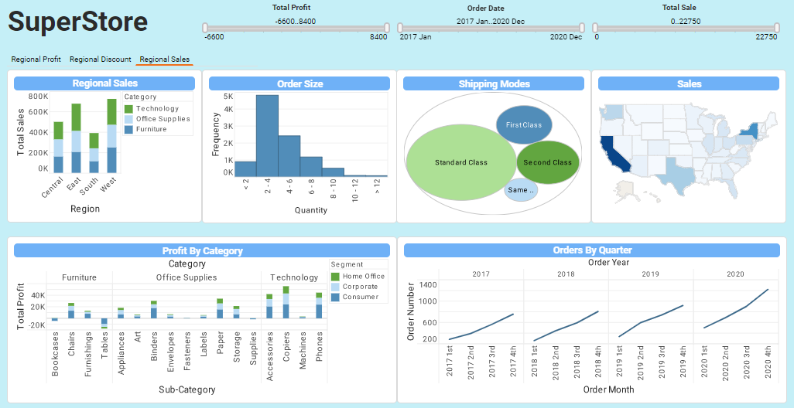
PROJECT OVERVIEW
Purpose: To analyze the performance and operations of Superstore
Scope: Examining various aspects such as sales, inventory management, customer satisfaction, and employee productivity
Objectives: Identify areas of improvement, enhance operational efficiency, and optimize overall performance

Slide 5
WHO ARE THE END USERS of this project?
Target audience: Superstore management, stakeholders, and decision-makers
Characteristics: Responsible for strategic planning, resource allocation, and performance evaluation
Needs: Accurate and timely information, actionable insights, and recommendations for improving operations
Benefits: Enhanced decision-making, increased profitability, and improved customer satisfaction

Slide 6
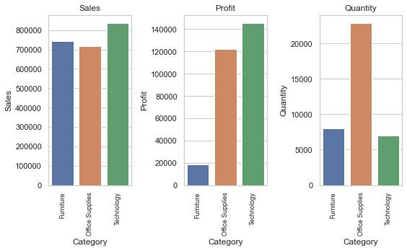
YOUR SOLUTION AND ITS VALUE PROPOSITION
Solution: Implementing data-driven analytics and performance management systems
Value proposition: Providing real-time visibility into key performance indicators, enabling informed decision-making, optimizing resource allocation, and improving overall operational efficiency

Slide 7
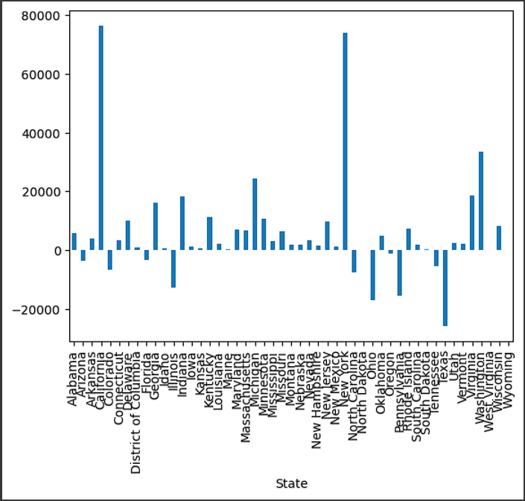
How did you customize the project and make it your own
Customization: Tailoring the analysis approach to Superstore's specific requirements and goals
Unique aspects: Integration of advanced analytics techniques, development of a custom dashboard for visualizing data, and implementation of predictive modeling for demand forecasting

Slide 8
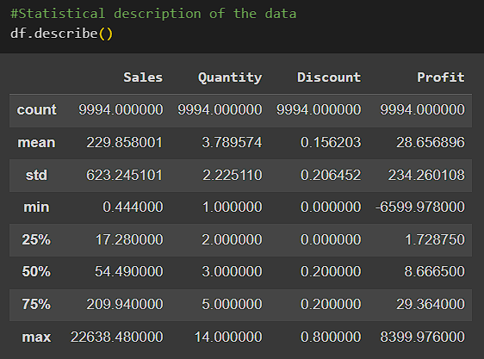
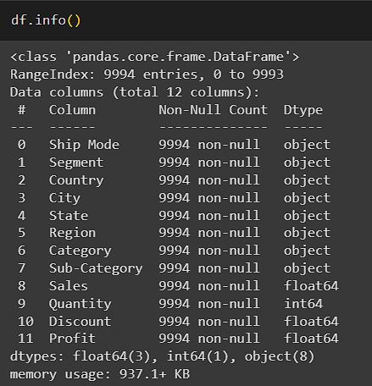
MODELLING
Following my discovery in the superstore's data, I took the dataset in understanding the issue by performing data cleaning. My steps were as follows:
Checked the summary statistics to identify any inconsistencies or outliers in the data.
Adding new columns to the dataset to capture additional information and insights.
Removed any duplicate records to ensure a high level of data accuracy.
Performed advanced techniques such as data imputation, outlier detection and handling, and data normalization to further improve the quality of the data.
By going through this thorough data cleaning process, we were able to uncover more information that would have been obscured by the inconsistencies and inaccuracies in the raw data. And with this newfound clarity, we were able to take the next step in our investigation and bring the superstore's financial struggles to a close.

Slide 9
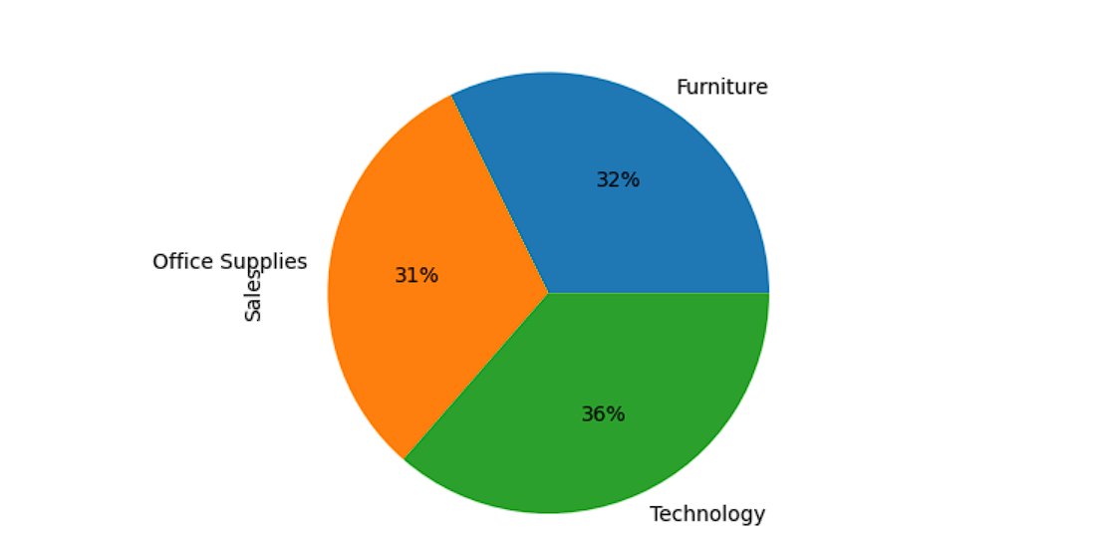
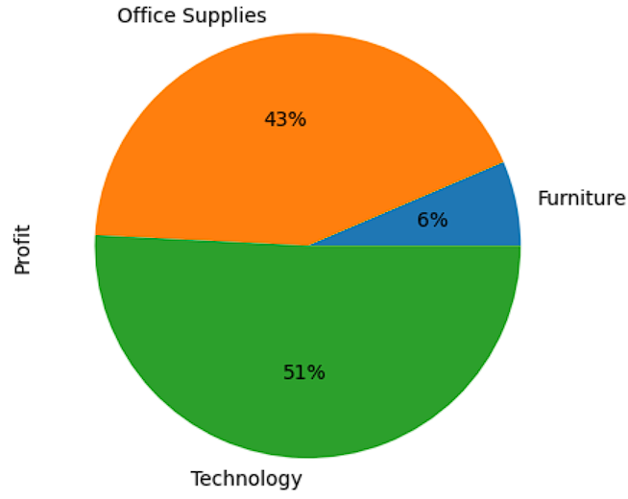
Results
From the above result we have come to conclude that the Sales and Profit are how co-relate with each other for every fields of the superstore dataset .
Qualitative feedback: Improved customer satisfaction scores, enhanced employee morale, and positive feedback from management
Evidence of success: Improved operational efficiency, streamlined processes, and increased profitability

Slide 10
links
https://github.com/alairdata/Superstore_Analysis
https://www.kaggle.com/datasets/vivek468/superstore-dataset-final
https://medium.com/clique-org/superstore-sales-use-case-data-analytics-and-visualization-62afacd0777
https://colab.research.google.com/drive/1Ej239BG3TjO7AruwDmIruFCQHablG4bP#scrollTo=EueW24iZR82u

Slide 11


